Slide 1
Water Level Monitoring Using HC-SR04 Sensor and Arduino IoT Cloud
A Real-Time Monitoring Solution for Water Levels
Rayan alshubli 221423496 Ahmed mansour 221433714 Suervision : Dr.abdullah albuali

Slide 2
Abstract
Design a real-time water level monitoring system.
Uses HC-SR04 ultrasonic sensor and Arduino IoT Cloud.
Displays water levels on a cloud-based dashboard using a Gauge widget.

Slide 3
Objective
Goal: Build an affordable and efficient water level monitoring system.
Real-time data updates
Remote monitoring
Cost-effective
using Arduino IoT Cloud.
via cloud-based dashboard
solution for flood-prone and water resource management areas.

Slide 4
System Components
01
02
Hardware
HC-SR04 Ultrasonic Sensor: Measures distance to the water surface.
Arduino Board: Processes sensor data and connects to the IoT Cloud.
Internet Module (WiFi/Ethernet): Transmits data to the cloud.
Software
Arduino IDE for programming.
Arduino IoT Cloud for dashboard and data visualization.

Slide 5
Wiring Diagram

Slide 6
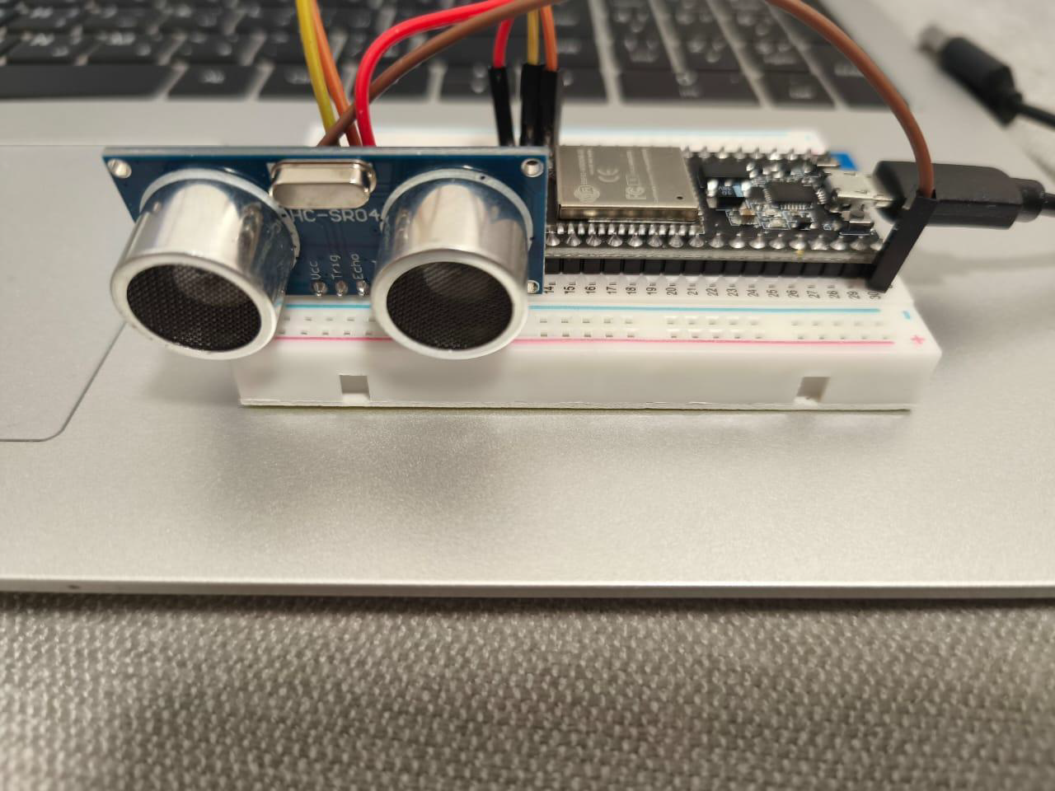
Project Setup

Slide 7
Methodology
Step 1: Connect the HC-SR04 sensor to the Arduino.
Step 2: Set up Arduino IoT Cloud, create a "Thing", and define the distance variable.
Step 3: Use a Gauge widget on the cloud dashboard to display real-time data.
Step 4: Monitor the water levels remotely via the IoT cloud.

Slide 8
Real-Time Monitoring and Dashboard
Real-Time Data
Gauge Widget
Accessibility
Updated continuously on the cloud dashboard.
Displays water level as a visual indicator.
Remote access through the IoT cloud interface.

Slide 9
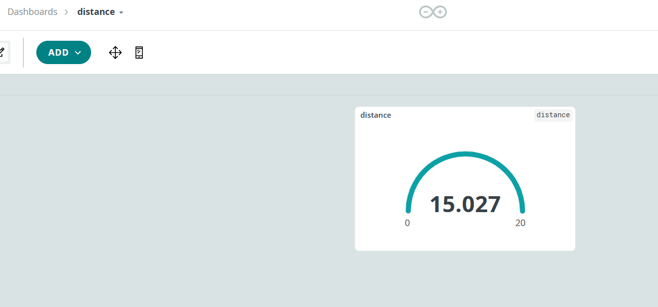
Old Dashboard

Slide 10
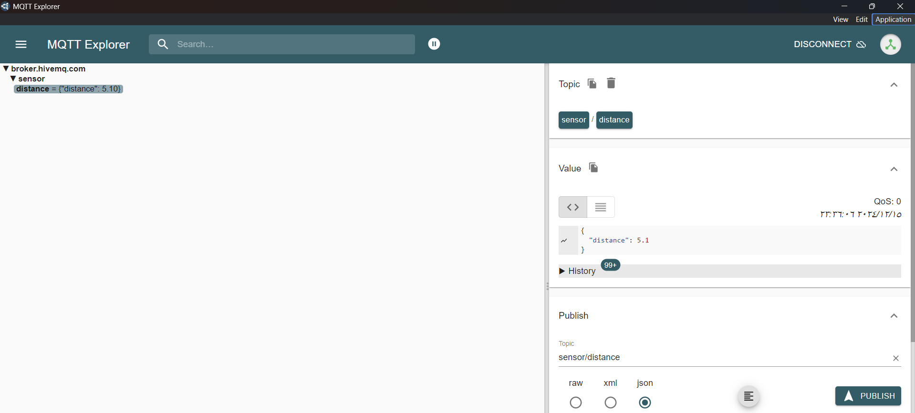
New Dashboard From MQTT

Slide 11
Testing and Verification
Real-Time Data Updates
Real-Time Monitoring
Verified that the distance variable was updated correctly in the dashboard.
Gauge updated dynamically, reflecting water level changes in real-time.
1
1
2
2
Gauge displayed updated values as water levels changed.
Successful data transmission from the sensor to the cloud and dashboard.

Slide 12
Benefits
Real-Time Monitoring & Visualization
Data Storage & Analysis
Interactivity
Instant updates on water levels via cloud dashboard.
Historical data storage for tracking trends and future analysis.
Immediate action based on the water level displayed on the Gauge.

Slide 13
Challenges
01
02
Real-Time Data Updates
Ensuring accurate data transmission from Arduino IoT Cloud to the dashboard required careful setup of variables and configuration.
Connectivity Issues
Ensuring stable and continuous Wi-Fi connection for data transmission.

Slide 14
conclusion
In conclusion, the water level monitoring system using the HC-SR04 sensor and Arduino IoT Cloud offers real-time data visualization and remote monitoring, providing an affordable and reliable solution for flood and water resource management. Despite minor challenges, the system proved effective and scalable for environmental monitoring.

Slide 15
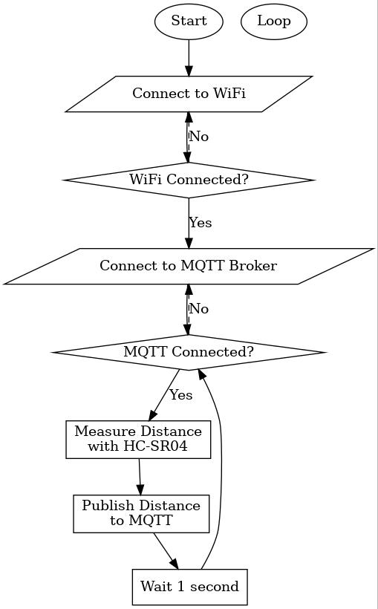
Flowchart

Slide 16
References
A. M. G. I. Rodrigues and F. J. A. Santos, "Water Level Monitoring using ESP8266 and Arduino IoT Cloud," Electronic Clinic, 2021. [Online]. Available: https://www.electroniclinic.com.
P. G. Sharma, "IoT based Contactless Water Level Monitoring with ESP32 and HC-SR04," Microcontrollers Lab, 2021. [Online]. Available: https://www.microcontrollerslab.com.
R. Chatterjee, "Automated Water Level Monitoring and Control System," GitHub Repository, 2021. [Online]. Available: https://github.com/chatterjee-rohan/Automated-Water-Level-Monitoring.
M. Martinius, "Water Level Monitor - Arduino / ESP8266 / ESP32 / Sigfox," Arduino Project Hub, 2022. [Online]. Available: https://projecthub.arduino.cc/martinius96/water-level-monitor-arduino-esp8266-esp32-sigfox-21ede7.

Slide 17
Thanks!
Do you have any questions?

